Slide 1
McMaster Research Ethics Board (MREB)
Nicole Gervais, MREB Research Ethics Advisor (REA)

Slide 2
3 Boards at McMaster
HiREB
Most clinical studies
Studies with a PI, student PI and/or faculty supervisor in FHS
Studies that examine health records
MREB
Most studies with a PI, student PI and/or faculty supervisor in any other faculty but HS
AREB
- Research with Animals
- https://research.mcmaster.ca/home/support-for-researchers/ethics/areb/

Slide 3
About Us
We’re not evil!
Protection of participants
We’re here for you too!
Protecting your Participant Pool
We are (or were) researchers ourselves!

Slide 4
History
Tuskegee Syphilis Study (1932 – 1972)
The Monster Study (1930s)
Nazi Experimentation/the Nuremberg Code (1947)
Willowbrook State School (1947-1987)
Henrietta Lacks and HeLa cells (1950 - )
MK Ultra (1953-1967)
The Aversion Project (1971-1989)
Golden Rice Study (2012)
Pictou Landing (2021)

Slide 5
Application process
MacREM https://reo.mcmaster.ca/macrem
- Sign in with MacID
- Externals need MacID to create/sign application
HiREB https://onlinesubmission.hireb.ca/Account/Login?ReturnUrl=%2fHome%2fIndex
- All people must register

Slide 6
Key Considerations – the “6Cs”
Clear
Considerate
Complete
Confidential
Consistent
Capable

Slide 7
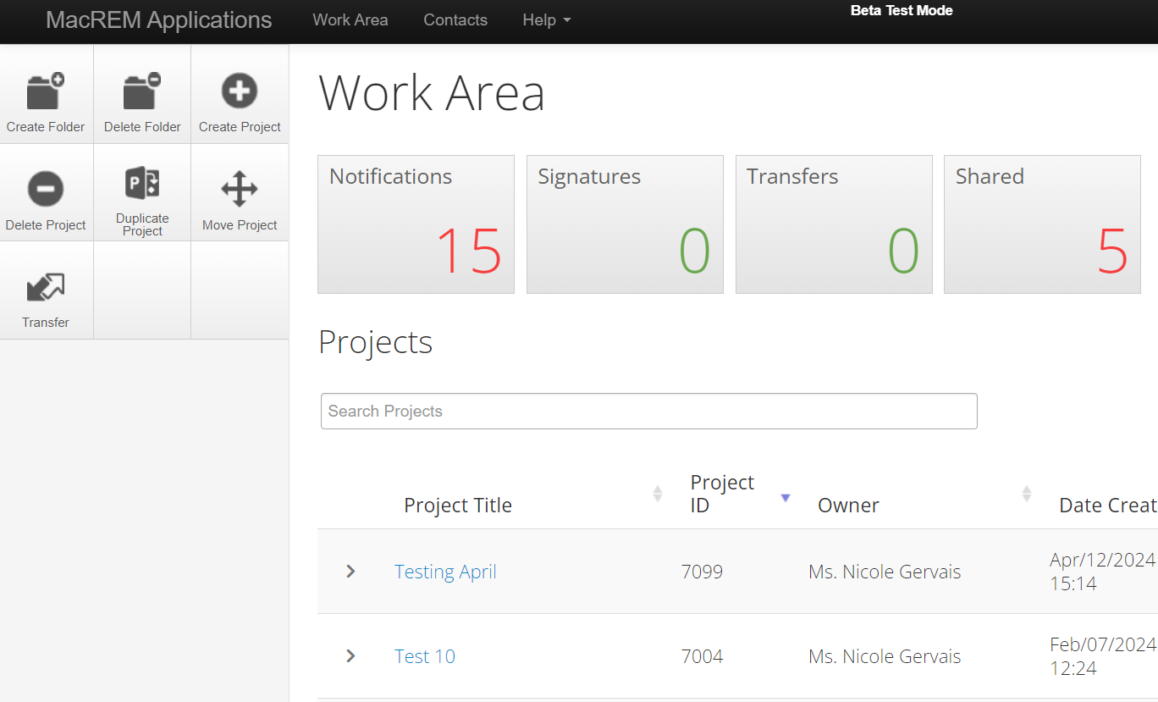
System Tips
Organization ->
Changing Ownership ->

Slide 8
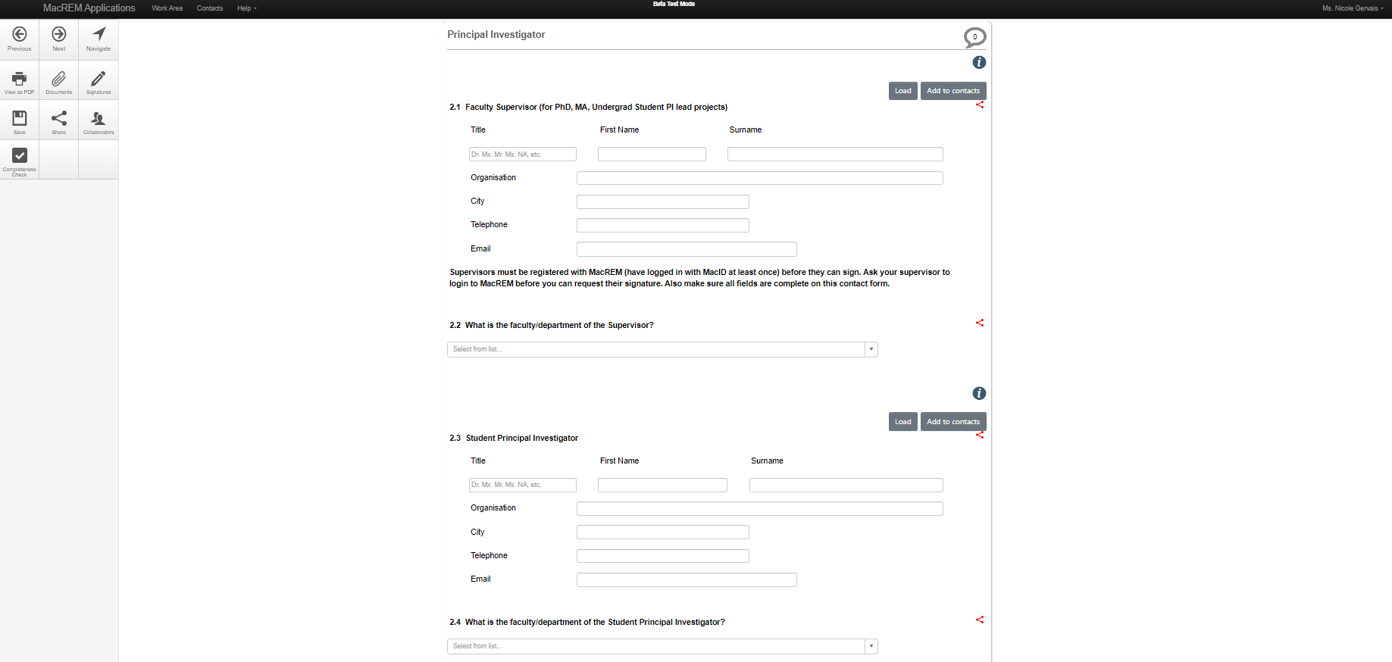
System Tips
˄ Templates and Guides
<- Communication Tool
<- Sharing with External people
<- Add to address book!
<- Extra Information

Slide 9
SECTIONS 1 & 2 – General Info
A summary of changes needs to be included in all resubmissions from Chair comments
Ensure it’s for the current round of changes
Easiest: copy/paste the letter and add comments
Add in any additional changes made
Co-I vs Collaborator: Student PI vs RA vs Student Investigator
Consider contributions and outcomes/requirements

Slide 10
Sections 3 & 4 – Summary and funding
Ensure you use lay person language
Guide: https://macrem.mcmaster.ca/Personalisation/DownloadTemplate/53
Double check your start/end dates – particularly year
Does your end date give you enough time?
Be sure to contact us when your funding situation changes

Slide 11
Section 5 – Study Locations
Institutions differ in regards to whether they will accept clearance from other REBs. Make sure you check with all relevant boards
Relevant boards include those that oversee the research team members, and likely even those sites you wish to recruit from
If your participants currently live outside Canada, you have to check “outside Canada”, even if all your data collection will be done virtually.
If you are working outside Canada (exceptions of the USA and Britain), you want to list an ad hoc reviewer. It helps if you confirm they’re willing to do it before submitting their name

Slide 12
Section 6 – Indigenous Research
Doesn’t apply to incidental inclusion – only if you are specifically seeking their voice
If you are, it is very, very unlikely any request to waive community engagement will be granted
Even if there isn’t a formal steering group or research board at the sites you’re working at, attempts should be made to develop an informal group of community members
You may wish to touch base with MIRI or the Indigenous studies department
Ensure you’re following the principles of OCAP

Slide 13
Section 7 – Conflict of Interest
Consider every member of the research team
Employee salary’s do not count as a benefit for 7.2
Clear communication is the best mitigating strategy in many cases
Those with the least conflict of interest should have the most contact with the participants

Slide 14
Section 8 – Background and Hypothesis
Use lay person language
References are not necessary (but not wrong)
Only include the research components

Slide 15
Section 9 - Participants
Inclusion vs exclusion criteria
Split info into groups if required
Ensure sample sizes are appropriate and feasible

Slide 16
Section 10 - Recruitment
Where are you getting your “leads”?
Include all relevant info in ads (time, recording, study team)
Holders of participant contact
Avoiding conflict of interest

Slide 17
Section 11
Ensure all details are included (e.g. recording)
Consider if cloud-based software will be used
Don’t forget to include instructions/stimuli
Focus group introductions should speak to privacy

Slide 18
Section 12 – Secondary use of data
To show the information received, a copy of the questionnaire/interview guide is best
If at all possible, the holder of the data should anonymize it before it is shared with you

Slide 19
Section 13 - Incentives
Incentives vs benefits
Explain how the incentive will be given (cash, etransfer, gift card)
Incentives should not be withheld if study isn’t fully complted

Slide 20
Section 14 – Risks and Benefits
Don’t overstate or understate
There is a potential for at least minor psychological and/or social risks in all studies
Benefits are intangible positives that may or may not come, simply from taking part
If there is a potential for significant risk, you must have a mitigation plan in place
If using a list, ensure it is appropriate for the population and risk level

Slide 21
Section 15 - Data
15.1-15.4: Admin Info 15.5-15.11: Data
Collect the least amount of identifiable information required to run the study (e.g. age rather than birthdate)
Consider if you will have both paper and electronic data
Hard copy data should not be kept at home if possible
Personal information should be held separate from study data
Protect data from airport security/customs

Slide 22
Section 16 - Consent
How will you guarantee that the person understands the consent?
Oral consent – needs either a consent log and script or an explanation of reading the full consent form
If working with children, how will you assess assent? Continued assent
Withdrawal – there should be at least a short withdrawal period if feasible. This should be clearly explained

Slide 23
IMPORTANT
Do NOT start data collection before receiving REB approval
If you want/need to change anything minor about the project (add a co-I, change a start date), use the “Add FIO” sub-form
If you want/need to change something larger (going from online to in-person data collection), use the “Amendment” sub-form
Try not deviate from the approved process without first obtaining REB approval (unless there is a risk to a participant)
If a deviation does occur, there is a “Reported Event” – VERY RARE
Yearly renewals are required
Don’t forget to close the study when you are done collecting data!

Slide 24
RESOURCES
McMaster’s “Research Involving Human Participants” (2002)
McMaster’s “Research Integrity Policy” (2017)
Canada’s “Tri-Council Policy Statement – Ethical Conduct for Research Involving Humans” (TCPS 2 – 2018)
TCPS2 Core Certificate
Regulations re clinical trials (GCP, PHIPA, Division 5 drugs) – see HiREB

Slide 25
ASSISTANCE
Templates and Guides are available!
Under the “Help” tab within the MacREM system
Study Templates and Guides: https://research.mcmaster.ca/home/support-for-researchers/ethics/macrem/macrem-templates/
MacREM Guides: https://research.mcmaster.ca/home/support-for-researchers/ethics/macrem/
We’re always available for questions and meetings

Slide 26
QUESTIONS?

