Slide 1
McMaster Digital Research Support Updates
Departmental Overview
Fall 2022 / Winter 2023

Slide 2
Overview
The Digital Research Commons Pilot
McMaster’s Institutional RDM Strategy
Research IT Security

Slide 3
About the DRCP
What is it?
Who is involved?
Why are we doing it?

Slide 4
Digital Research Commons Pilot (DRCP)
A 3-Year SAF-funded project; co-sponsored by the Office of the VPR, the University Library, and the Office of the AVP & CTO.
Vision
To build a more connected, capable, and researcher-focused approach to digital research support, which will improve access to systems, services, software, and training for researchers across the institution.
Leads
Jay Brodeur - McMaster University Library
Angela Di Nello - Research & High-Performance Computing Support (RHPCS)
Tracy Dallaire - Office of the AVP & CTO
Ranil Sonnadara - Office of the VPR
Notes:
number of us that are co-leading this initiative reflecting the c-sponsorship of the pilot

Slide 5
Digital Research Commons Pilot (DRCP) mission
Researchers
Local
Faculty Members
Services
Should be able to access
Graduate Students
Training
Postdoctoral Fellows
Service Providers
Service Providers
Resources
Should be guided by needs of
External
Undergraduates
Systems
Research Staff
Mission
The DRCP will build into and around existing digital research support, so that:
Researchers can easily find and use the services, systems, training, and resources they need to succeed in their research.
Service providers and support units can collaborate to identify support gaps and develop complementary and shared services that meet diverse needs across campus.
Notes:
In an ideal state, researchers--no matter their role--can access the supports they need for research, whether offered through local service providers or those are provincial or national levels
At the same time, service providers should have thorough knowledge of digital research needs across campus and should work together to meet them.
It’s this virtuous cycle that the DRCP aims to build, and we intend to do this by building into and around existing digital research support, so that:
1. Researchers can easily find and use the services, systems, training, and resources they need to succeed in their research.
2. Service providers and support units can collaborate to identify support gaps and develop complementary and shared services that meet diverse needs across campus.
Systems, services, software required for research, and the necessary expertise and training to use them effectively.
Across campus, DRI support needs are diverse and dynamic
Many different groups contribute to DRI support
Challenges:
Unavailable or inaccessible services, supports, etc.
Lack of researcher awareness of existing resources
Duplicated efforts by supporting units

Slide 6
Key Functions
Engage with the community
Identify needs, gaps, opportunities for collaboration
Co-create a vision for coordinated digital research support
Develop shared resources, services, communities
Provide researchers a single support interface
Compile and present information about local, provincial, or national services and training opportunities
Research Data Management, Research IT Security
Research Impact, Research Software Development
Online Data Collection
Assess our approach
Continually assess and refine the pilot – during and after
Deliver support services to help researchers find what they need
Notes:
Engage with research stakeholder groups to identify opportunities for meaningful collaboration and co-create a vision for coordinated digital research support at McMaster.
Pilot shared resources, services, and communities of practice that require coordinated governance, with an initial focus on research data management, research IT security, research impact, research software, and online data collection. All of these services that require multiple units on campus to work together to be able to support what researchers want to do
Provide researchers a single interface to find information about (and get help with) digital research support. Compile information about services available through local, provincial, or national service providers.
Continuously assess and refine our approaches to guide efforts during and beyond the pilot. CIPP: Context, Input, Process, Product (CIPP) Evaluation

Slide 7
drcp Teams
Research Data Management (RDM)
Isaac Pratt
Danica Evering
Information Security for Researchers
Greg Atkinson
Miro Cika
Danny Johnston
Kevin Wong
Core
Admin
Jay Brodeur
Angela Di Nello
Tracy Dallaire
Ranil Sonnadara
Research Impact
Jeff Demaine
Jack Young
Kestrel McNeill
Katie Sonier
Matthew Burns
[Future RSA]
Research Software Development
Dave Beardwood
Ola Hejazi
Kelvin Lee
Elias Eid
CIPP Evaluation
Kestrel McNeill
Katie Sonier
Matthew Burns
Notes:
Much of the DRCP’s capacity arises through the in-kind contributions of and collaboration between existing staff in the McMaster University Library (MUL), University Technology Services (UTS), the OVPR, and Research and High-Performance Research Support (RHPCS).
As of February 1, 2023, the DRCP team comprises 18 individuals; 14 of whom are contributing to the initiative through in-kind funding contributions.

Slide 8
Research Data Management: Institutional Strategy
Notes:
Within the DRCP, our role is to care for research data throughout its lifecycle. RDM impacts all researchers; our Institutional Strategy will coordinate and improve RDM services, we need to make sure your needs as a department are reflected in the strategy.

Slide 9
What is Research Data Management?
Discovery and Reuse
Planning
Reproducibility
Open access
Persistent identifiers
Data Management Plans
Grant applications
Ethics applications
Research proposals
Data sharing agreements
Manage
Data storage
Data security
Data publications
Publication and Sharing
Archival
Data Collection
Data deposit
Data repositories
Access controls
De-identification
Electronic lab notebooks
Analysis
File management
Folder organization
Metadata
Collaborative tools and software
Data Documentation
Notes:
Part of Digital Research Commons Pilot! All researchers gather research data, so they do some form of Research Data Management or RDM. What it looks like varies from field to field. RDM is a set of connected processes and practices, which are applied throughout the research lifecycle.
Planning (Data Management Plans, grant applications, ethics); Data Collection (access controls, de-identification, electronic lab notebooks); Analyze (file management, folder organization, collaboration); Publication and Sharing (data repositories where data can be shared, archiving, metadata); Discovery and Reuse (reproducibility, open access, persistent identifiers, data sharing agreements).
Strategy needs to attend to each stage of this cycle.

Slide 10
RDM Services Support Research + Teaching
Consultations: Available for students, postdocs, faculty, and staff with any RDM-related questions
Class Visits + Course Modules: For graduate and undergraduate levels.
Training: Introductory and focused training workshops Current events series for 2022-23 and previous recordings available for asynchronous learning.
Website: Overview and resources through the research cycle: Secure, Plan, Find, Organize, Store, Publish, and Archive data.
Data Storage Finder: McMaster-specific interactive tool - find a vetted storage provider based on risk, volume, and more.
DMP Assistant: interactive tool for data management plan creation - templates and exportable plans to fulfill grant requirements.
McMaster Dataverse: Institutional data repository for sharing research data. Part of the Canada-wide Borealis Repository.
Notes:
We also have training, services, and supports already developed to support researchers and researchers in training. This will expand in relation to the RDM strategy. If you’re doing RDM-related activities or are curious, please reach out. We’re doing several class visits to Methods classes this fall, and are happy to provide custom training to you, your research teams, and your students.
Consultations: Available for students, postdocs, faculty and staff with ay RDM-related questions
Class Visits + Course Modules: For graduate and undergraduate levels.
Training: Introductory and focused training workshops Current events series for 2022-23 and previous recordings available for asynchronous learning.
Website: Overview and resources through the research cycle: Secure, Plan, Find, Organize, Store, Publish, and Archive data.
Data Storage Finder: McMaster-specific interactive tool - find a vetted storage provider based on risk, volume, and more
DMP Assistant: interactive tool for data management plan creation - templates and exportable plans to fulfill grant requirements.
McMaster Dataverse: Institutional data repository for sharing research data. Part of the Canada-wide Borealis Repository

Slide 11
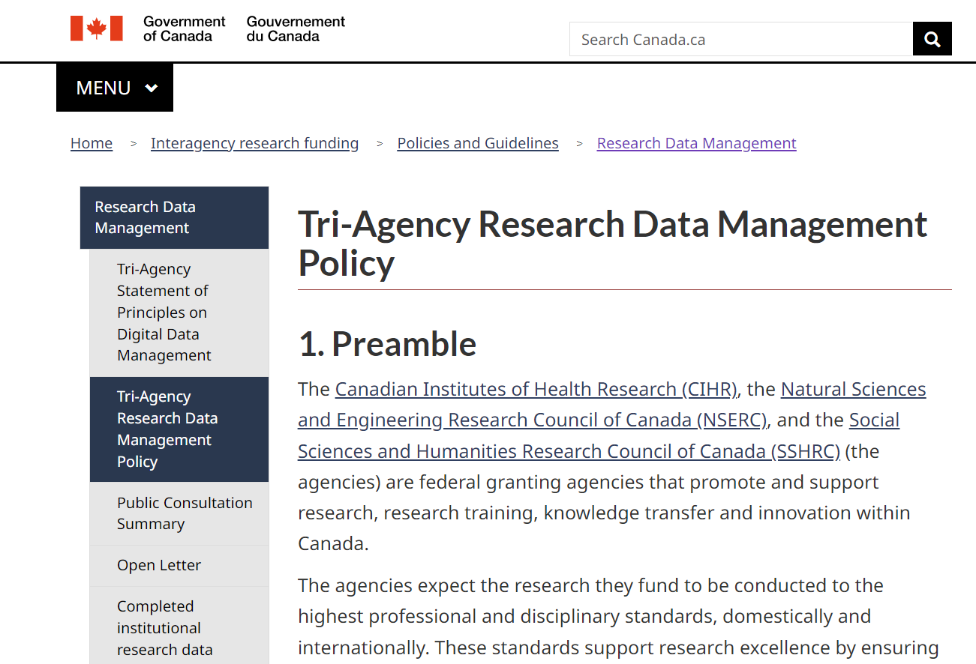
Tri-Agency RDM Policy 2021
Tri-Agency RDM Policy
2021
Institutional Strategies
Data Deposit
Data Management Plans (DMPs)
Notes:
In March 2021, the Tri-Agencies released a Research Data Management Policy to advance Canadian research excellence and ensure that publicly funded research is supported by sound RDM and data stewardship practices.
The policy has 3 pillars – a requirement for researchers to deposit research data online (in the future, not data sharing), a requirement for data management plans to be submitted with grant applications (in process), and a requirement for institutions to create and publish Institutional Strategies for supporting RDM. We’ve been working since then to develop a strategy for McMaster.
SSHRC
Partnership Grants Stage 2 (Anticipated launch summer 2023)
DMP Assistant Tool - https://rdm.mcmaster.ca/plan. We will also soon have a list of DMP exemplars, including those for Social Sciences.
SSHRC also has some specific data related requirements currently in force which were initially established in 1990 and updated in 2016. Researchers are required to:
Preserve and make available for use by others all research data collected with the use of SSHRC funds. This must occur within “a reasonable period of time.”
SSHRC considers "a reasonable period" to be within two years of the completion of the research project for which the data was collected.
Could be a box-checking measure, throw something together that meets the funder’s expectations and publish it. We want to embody the same considered process as the research this strategy will support.

Slide 12
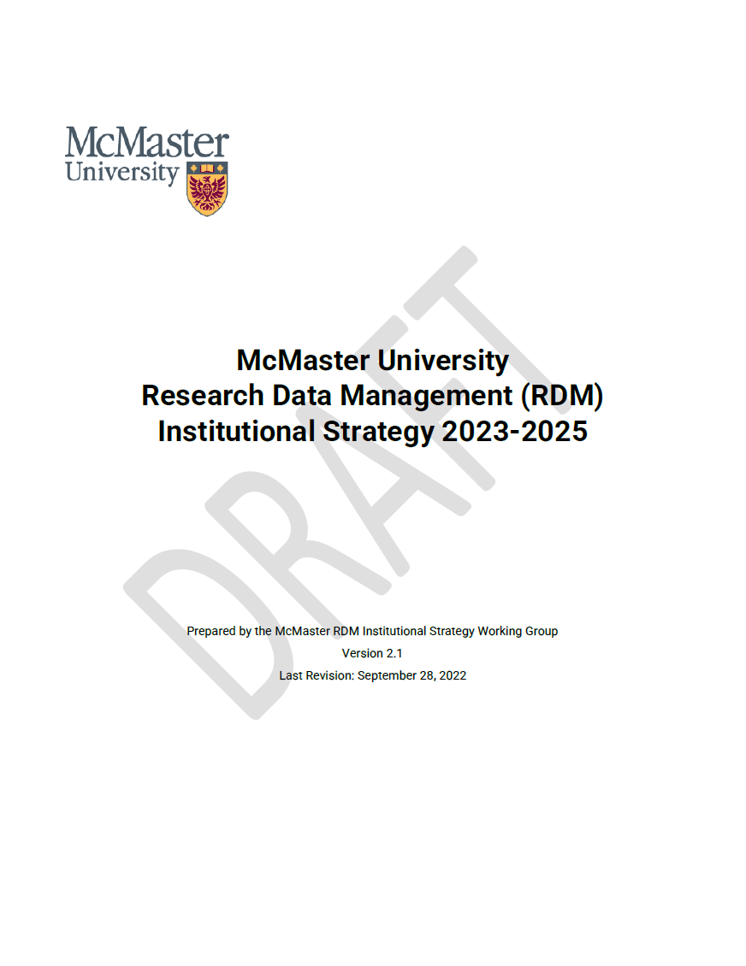
McMaster’s Institutional Strategy For Research Data Management
Vision:
Support our researchers in producing the highest quality research, meeting disciplinary and funder expectations, and leading the adoption of RDM best practices
Provide a researcher-focused integrated framework of interconnected and complementary services, infrastructure, policies, practices, guidelines, tools, technologies, training, and support.
LINK TO STRATEGY
Notes:
The draft version of the strategy was sent to you in advance of this meeting and is available for viewing online at the link here – we’ve also put the link in the chat.
NIH also has a new Data Management and Sharing Policy which could impact you as researchers too. This Strategy is meant to extend beyond that.

Slide 13
Institutional Strategy Development Process
An environmental scan of RDM services provided by McMaster
An online survey of researcher’s RDM needs
A series of focus groups with researchers, research centres and institutes, and services
A maturity assessment of current services and infrastructure using a model built for RDM at universities
Feedback from over 250 members of the McMaster research community
Notes:
To inform this Strategy, McMaster RDM Services (on behalf of the ISWG) conducted an in-depth data collection and consultation process involving researchers, research service providers, and other stakeholders on campus. The consultation process involved 4 major projects: an environmental scan of RDM related services provided by McMaster, an online survey of researcher’s RDM needs, a series of focus groups, and a maturity assessment of RDM services.
Together these efforts gathered feedback from over 250 members of the McMaster research community, which was compiled into two summary documents: Current State of RDM at McMaster (2022) and A Vision for RDM at McMaster (2022). From these, we worked to bridge the current state and the ideal state through the Institutional Strategy Document.

Slide 14
Institutional Strategy Principles
Research excellence & integrity
Indigenous data sovereignty
Collaboration & coordination
Researcher-centered support
Global research leadership and impact
Research security
Notes:
Research excellence & Integrity: supporting research excellence by promoting sound RDM and data stewardship practices
Indigenous data sovereignty: McMaster research by and with Indigenous researchers and communities will embody and exemplify Indigenous data management practices developed and approved by these communities
Collaboration & coordination: building a culture that promotes effective and lasting partnerships and knowledge sharing between RDM stakeholders across campus, including researchers, administrators, IT service providers, research ethics boards (REBs), the libraries, research administration offices (ROADS, HRS, MILO), McMaster Indigenous Research Institute (MIRI), Indigenous Health Learning Lodge (IHLL), and other service units
Researcher-centered support: a core set of RDM services will be available to all members of the institution who require them, regardless of their role or discipline. Services development and delivery will be guided by and responsive to researcher needs
Global research leadership and impact: we will strive to be an innovator and leader in RDM practices, support, and training to support McMaster’s global research leadership
Research security: McMaster will ensure that researchers have access to the knowledge, infrastructure, and support to protect their research instruments and data from unwarranted access, compromise, and loss

Slide 15
Institutional Strategy Stakeholders
University Leadership
Researchers
Research Support
Data Leadership
Governance
Support
Data Champions
Research Excellence
Engagement
Internal Knowledge Transfer
Coordination of Services
Service Innovation
Notes:
Each stakeholder group plays an important role in promoting, supporting, and applying best RDM practices.

Slide 16
Institutional Strategy – Goals + Objectives
Organizational Frameworks
Governance and Policy
Funding and Support
Culture, Community, Collaboration
Services and Training
RDM Practices, Tools and Infrastructure
Data Management Planning
Data Storage
Indigenous Data
Data Ethics and Sensitive Data
Data Documentation, Sharing, Access
Data Security
Software and Applications
Notes:
Organizational Frameworks – institutional and community supports
Practices, Tools, and Infrastructure which are areas of focus for researchers. Organizational Frameworks in development cohere around:
Governance and Policy: RDM policies, procedures, guidelines; strategy, roles and responsibilities; communication and assessment.
Funding and Support: Equitable funding for students and academics and units with smaller research budgets; scalable support.
Culture, Community, and Collaboration: Incentives; raising awareness about RDM and RDM services; and finding moments of interdisciplinary knowledge exchange; as well as those on campus who can champion RDM.
Services and Training: Equalizing service across campus, building a Research Commons – single place for accurate and current information. Central RDM services, and training across levels.

Slide 17
Strategy Development Timeline
Preparation
First Draft
Second Draft
Third Draft
We are here
Fourth Draft
Final Version & Launch
Working group formation
Institutional Strategy Working Group (WG) Review
Research Information Technology Committee (RITC) Review
Research Community Review
WG Approval
Final Draft
RITC Approval
Media article
Outreach
Town Halls
OVPR Approval
Website
RDM Current & Ideal State Documents
Vice President Research (OVPR) Review
Department visits
Glossy Document
Focus Groups
April 2021 – August 2022
August 2022
September 2022
October 2022 - January 2023
February 2023
March 2023
Notes:
April 2021-August 2022: Preparation (Working group formation, outreach, RDM Current & Ideal State Documents)
August 2022: First Draft (Institutional Strategy Working Group (WG) Review
September 2022: Second Draft (Research Information Technology Committee (RITC) Review, Vice President Research (OVPR) Review
October 2022-January 2023: Third Draft (Research Community Review, Town halls, Department Visits, Focus Groups)
February 2023 (We are here): Fourth Draft (WG Approval, RITC Approval, OVPR Approval)
March 2023: Final Version & Launch (Final Draft, Media Article, Website, Glossy Document)

Slide 18
Town Halls + Focus Groups
Town Hall (Recording):
With presentations from Matthew Lucas, Executive Director, Corporate Strategy and Performance, SSHRC on behalf of the Tri-Agencies about the new RDM Policy and McMaster RDM Services on how McMaster’s RDM Strategy was developed.
Recording is available at: https://scds.github.io/intro-rdm/townhall.html
Feedback Form: If you were unable to attend the Town Hall or wish to share more detailed feedback, you can use this anonymous feedback form (u.mcmaster.ca/rdm-feedback) or contact rdm@mcmaster.ca.

Slide 19
Information Security for Researchers – 2023 Roadshow
Digital Research Commons Pilot (DRCP)

Slide 20
Information Security Services Team – Who We Are
Offering our IT Security expertise, advice, and consultation to keep the McMaster community safe from online cyber threats.
Service Offerings:
Security Consultations & Reviews
Creating and Enforcing Security Policies
Intrusion Protection on IT Systems
Identity and Access Management

Slide 21
Where does ISS fit into the DRCP?
Bringing learning and awareness to forefront in terms of protection against intellectual property of research data and data theft.
Lead to creation of training modules that will be posted on Avenue2Learn with a tentative timeline of early 2023.
Goal for modules to be a collaboration & iterative between us and you, the research community! Your feedback will truly shape how these modules will be developed!
Courses will continue to be improved following AODA standards.

Slide 22
Modules Overview
Topics with some applicability
Data Storage (local/networked/cloud storage, backups, ...)
Intro to Research Data Management (data management planning, data deposit...)
IT Security Topics for the McMaster community
Cyberattacks (malware, ransomware, ...)
Incident Response (IT Security, contacts at McMaster)
Mobile Security (overview of mobile security issues)
Multi-factor Authentication (brief overview and McMaster MFA contacts)
Passwords (guidelines, some McMaster specifics)
Physical Computer Security (locks, physical impersonation, …)
Social Engineering (phishing, impersonation, ...)
Web Usage (recommended practices for web use)

Slide 23
Lab and Office Placement of IT Systems
As part of our extended service offering; various blueprints are currently in development in order to properly standardize how IT systems are being connected to the McMaster IT network.
These blueprints will act as the foundation for future expansion and development of spaces, reduce guesswork, and improve overall security for our research community.
Our team can be flexible & adapt the blueprints to suit your needs and confront while maintaining the IT Security standards we’ve already put in place.

Slide 24
Blueprint Example

Slide 25
In Summary
The ISS team is here to support you with regards to protecting your research data from theft and intellectual property from the hands of cyber criminals.
Whether it be through our training modules or blueprint template; we want to ensure you’re able to work with your research and data in a safe & secure manner.
If you have any questions or concerns with the training modules themselves or would like to provide your feedback to the Information Security Services team involved in the DRCP; please feel free to reach out to Information Security Research Analyst Miroslav Cika via email at cikam@mcmaster.ca

Slide 26
Please reach out!
Group | Email | Website
Digital Research Commons Pilot (DRCP) | askresearch@mcmaster.ca | u.mcmaster.ca/drcp
Research Data Management (RDM) | rdm@mcmaster.ca | rdm.mcmaster.ca
Information Security Services (ISS) | c-it-security@mcmaster.ca | informationsecurity.mcmaster.ca/
u.mcmaster.ca/drcp-feedback

