Slide 1
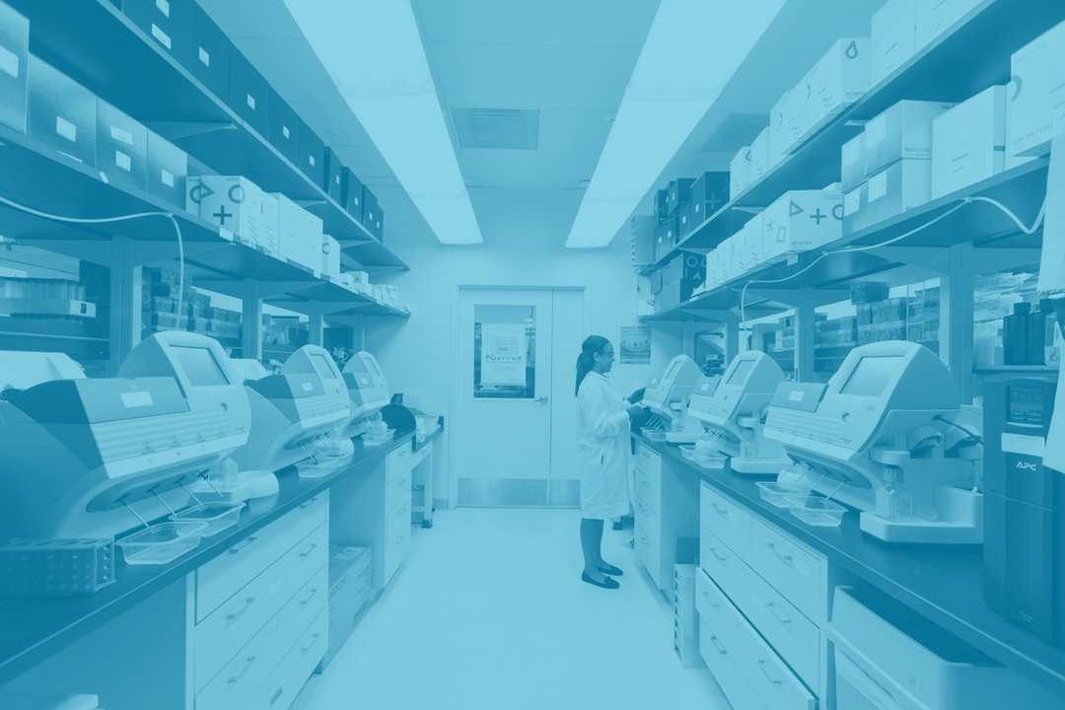
McMaster’s Phased Approach to Increased Research Activity

Slide 2
Assisting with Your Phased Return
Debbie Martin, AVP and Chief Facilities Officer
Wanda McKenna, AVP and Chief Human Resources Officer
Lisa Morine, Director, Health, Safety & Risk Management
Jonathan Bramson, Vice-Dean, Research, FHS
Tracy Arabski, Director, Health Research Services
Kathy Delaney, University Veterinarian
Karen Gourlay, Director, Animal Facilities
Gail Martin, Executive Director, Research, St. Joseph’s
Katie Porter, Director, Research Administration, HHS
Mark Stewart, Executive Director, Park Operations, MIP

Slide 3
Frequently Asked Questions - Themes
Physical/Social Distancing
Use of PPE
Buildings & Signage
Parking
Research Activity Plans
Graduate Students

Slide 4
Operations Team Update
Includes leaders from across the University
Sub-committees include:
Health and Safety
Human Resources
Wayfinding
Building Infrastructure

Slide 5
Health and Safety
Hierarchy of Hazard Control

Slide 6
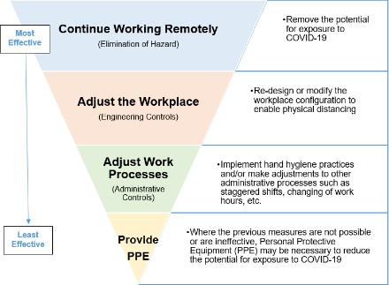
Continue Working Remotely
Working from home remains the preferred method of conducting research
All employees are to continue working at home unless they are expressly authorized to work on campus

Slide 7
Adjust the Workplace
Physical Distancing
Use of Office Space
Research and Use of Laboratories
Prepare the Physical State of Labs
Preparing for Subsequent Phases

Slide 8
Adjust Work Processes
Hygiene Practices
Adjustments to Shifts or Hours of Operation
Adjustments to Work Tasks or Deliverables
Adjustments to Methods of Working
Restricting University-Related Travel
Establish Standard Operating Procedures

Slide 9
PPE
Personal Protective Equipment (PPE)
To be used where the previous measures are not possible or are ineffective
Working in Labs
Masks
Cloth Face Coverings (are not PPE)
Eye Protection
Gloves

Slide 10
Facilities Management
Wayfinding
Signage
Building Infrastructure
Access
Cleaning schedules
Use of common areas
Lab deliveries
Transportation/Parking

Slide 11
Sites
Hospitals
Additional protocols/safety training
Clinical Trials
Coordination with clinics
Animal Facilities
Experiments
Protocols
Guidance

Slide 12
Research
Research Activity Plan
Options for scheduling work
Longer-term experiments
Planning ahead
Graduate Students
Involvement
Timelines
Training

Slide 13
Q&A
Regularly visit the research.mcmaster.ca/covid19 webpage for updated FAQs
Email additional questions to
research@mcmaster.ca

